Slide 1
Global Food Demands
The Challenge Underlying the Need for Skilled,
Future Agriculturalists

Slide 2
The Major Issues…
Population Growth
Availability and Sustainability of Resources
Future Choices & Decisions

Slide 3
Global Population growth
1 A.D. = approx. 300+ million people
1800 years later, 1804, approx. 1 billion
127 years later, 1927, approx. 2 billion
Before the end of the 1900’s, global population exceeded 6 billion people
10,000 BC

Slide 4
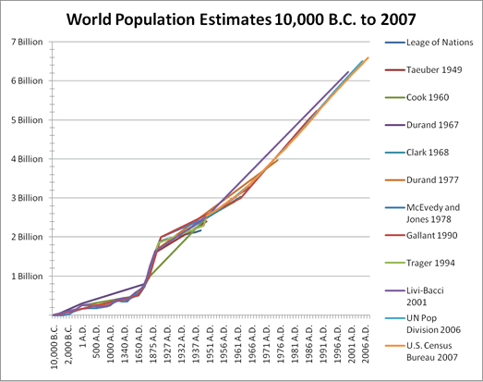
Population growth
In 2012, the global population exceeded 7 billion people.
By 2050, the global population is estimated to reach 9.5 to 10 billion people.

Slide 5
Population growth (cont.)
So what?.....what does this really mean?
Between today and 2050…….
1. The world population will increase by approximately 34%
2. The world population will also become more urbanized and affluent
3. Taking these factors into consideration, it is estimated that we will need to increase food production between now and 2050 by:
70% !!
Source: United Nations, FAO

Slide 6
Population growth (cont.)
So what?.....what does this really mean?
Annual production of cereal grains need to increase from 2.1 billion tons today, to 300 billion tons
Annual production of meat needs to increase from 270 million tons today, to over 470 million tons

Slide 7
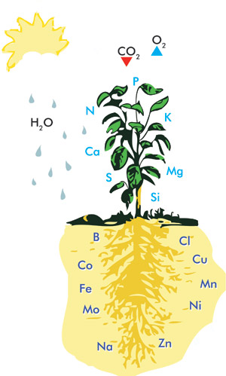
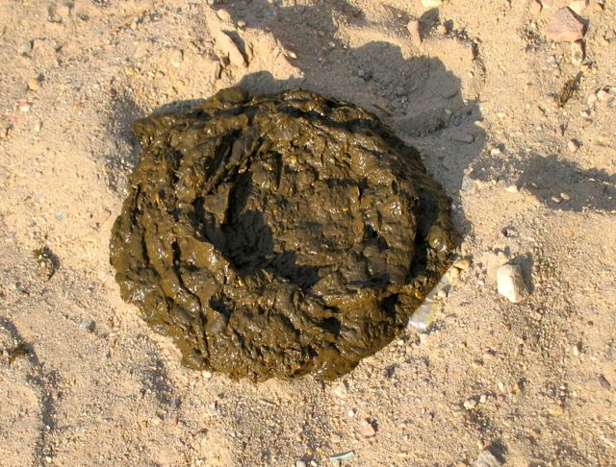
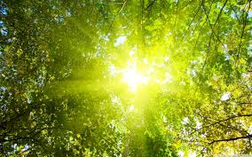
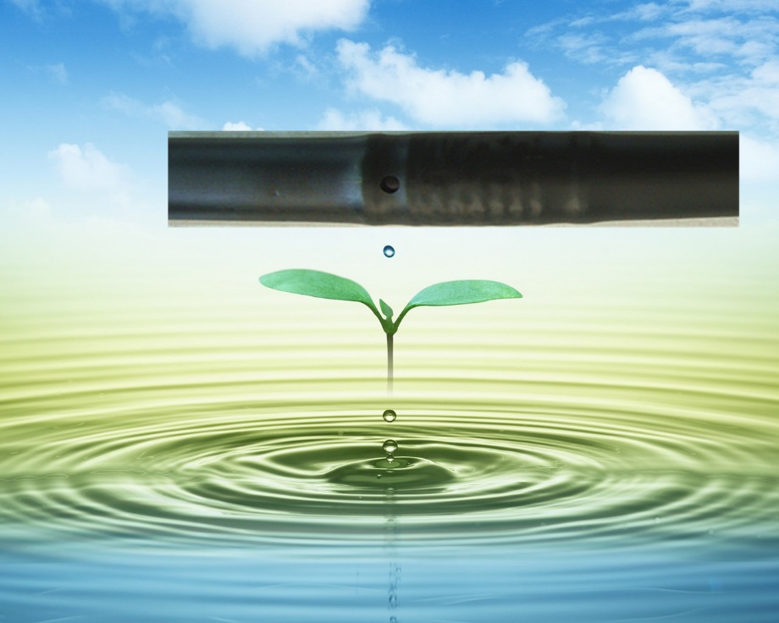
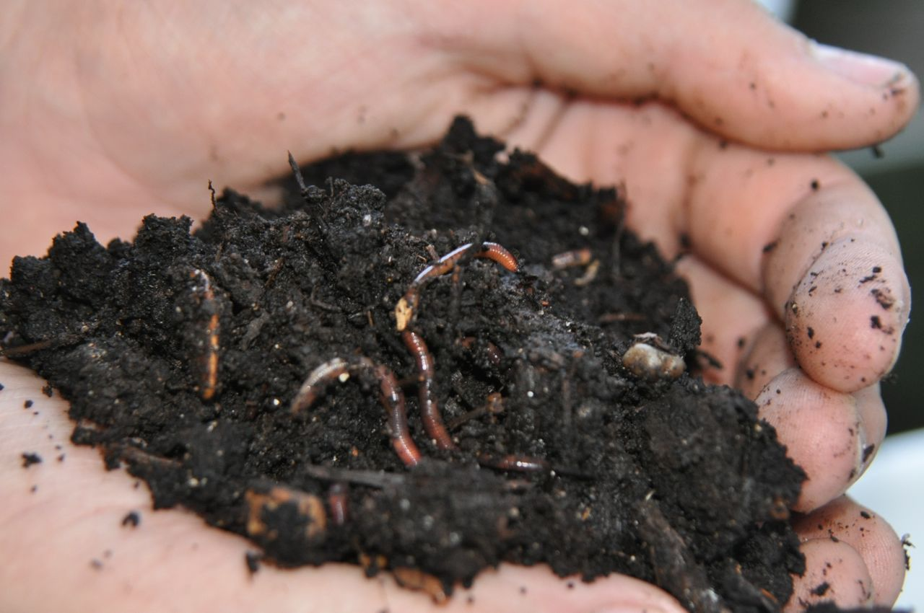
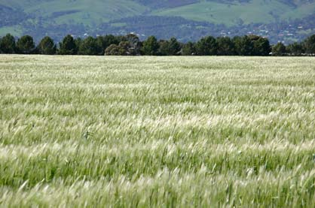
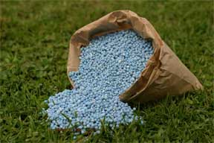
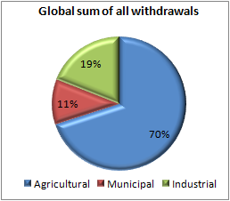
Primary Resources needed for the production of food……
Energy
Land
Water

Slide 8
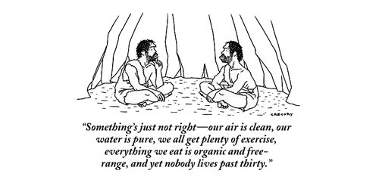
Future choices and decisions…..

Slide 9
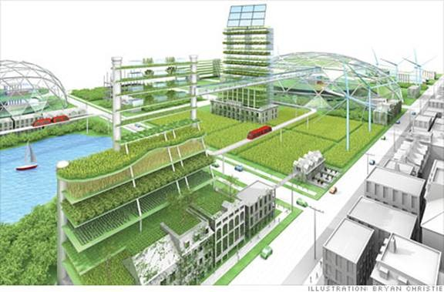
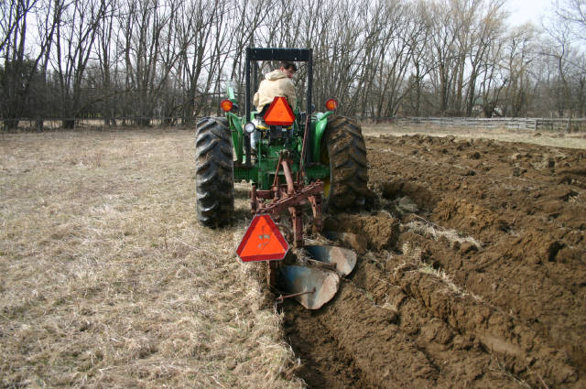
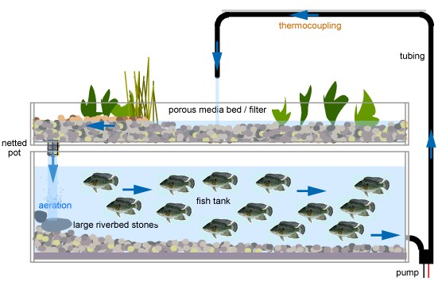
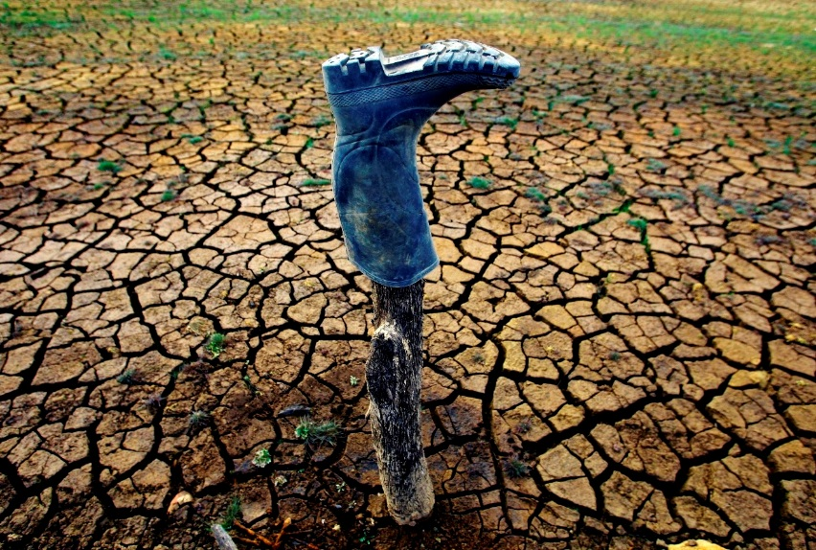
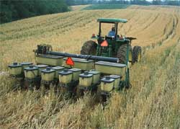
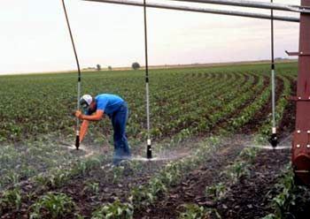
Future choices and decisions…..
Bridging the gap with knowledge and experience…..
Efficiency
Learning from past experiences
More focus on the sustainability of production practices

Slide 10
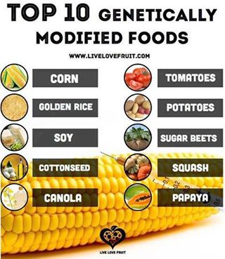
Future choices and decisions…..
Role of technology?........

Slide 11
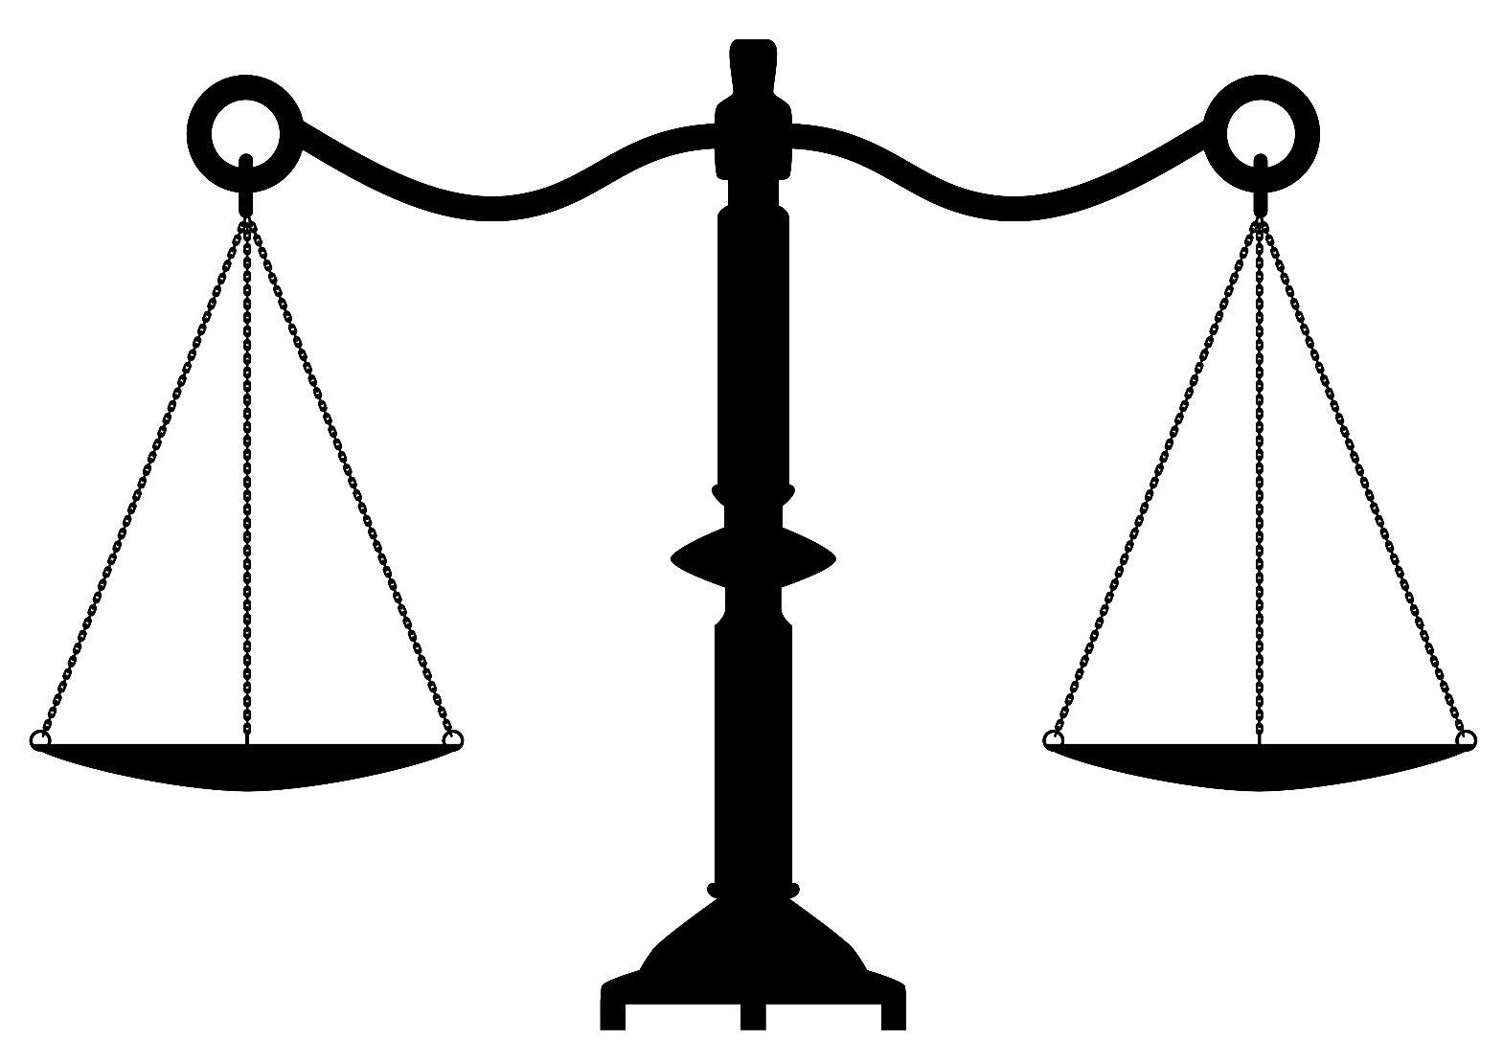
Future choices and decisions…..
Acceptable Food Production Practice
Food Abundance or Food Security

Slide 12
My conclusions regarding what we need to secure our world’s future…….
Need for more agriculturalists who are educated, knowledgeable, motivated, and creative……
Need for more agriculturalists that are knowledgeable about the relationships between production practices, science, and sustainability……
Need for more agriculturalists that think of themselves more as entrepreneurs, than as traditional producers…..
Need for more agriculturalists that can work in international settings……

Slide 13
We All Need you to help identify our future agriculturalists…..
Benjamin Keefer, Ph.D.
Agriculture Programs
Colorado Mesa University
Western Colorado Community College division
Grand Junction, CO

